Slide 1
Trainee enquiry system
TEAM :
Eswar Naidu(Data Analytics)
Neha(Database Management)
Suleman(Data Collection preprocessing)
Subodh Kumar(Quality Assurance)
Gaurav Mishra(Development)
https://github.com/GurramEswarNaidu/Revature_Project1.git

Slide 2
CONTENTS :
Project Description
Technologies
Flow of Project
MySQL Tables
Transferring tables MySQL to HDFS
Tables in the Project
Fetching data from Enquiry table to other tables.
Quries For Updating A New Record
Features

Slide 3
Project Description
This is a project which is created in hive.
The project was to create and maintain a database for candidate enrollment where they provide training for various courses .
We have created two tables in MySQL and import then to HDFS using SQOOP.
In this project we have created night tables from the two datasets.
We have performed various operations in this project like table join , partitioning, updation etc. We have also performed queries in tables where we have extracted the data from it.
We have run this project in hive terminal in GCP and CDH5.

Slide 4
Technologies
MySQL – To create and Store data
SQOOP – To transfer data from MySQL to HDFS
HIVE – To process the data
HUE – For visualizing the Tables

Slide 5
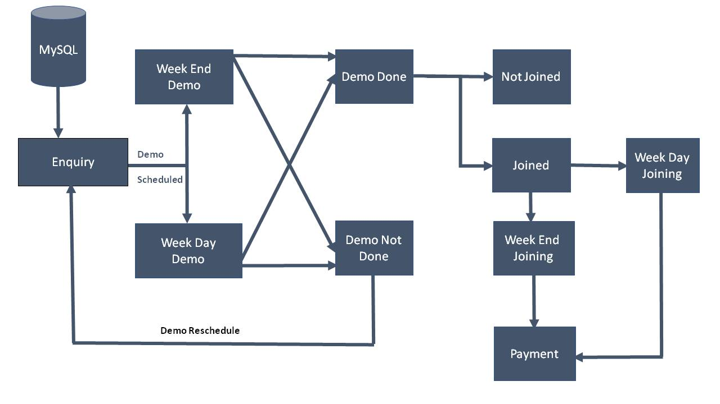
Project Flow

Slide 6
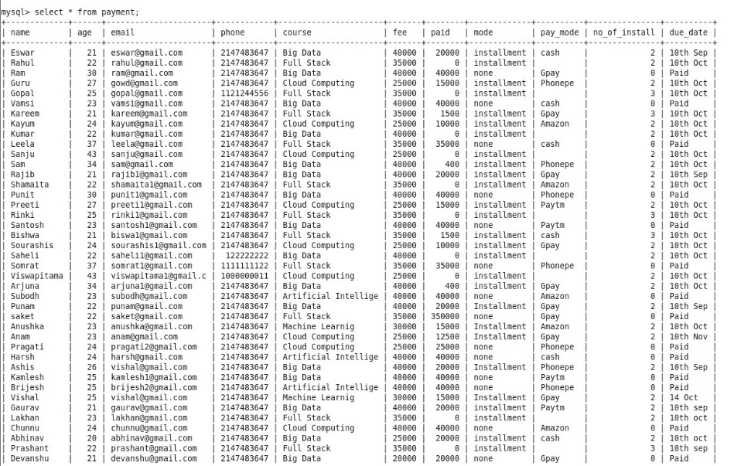
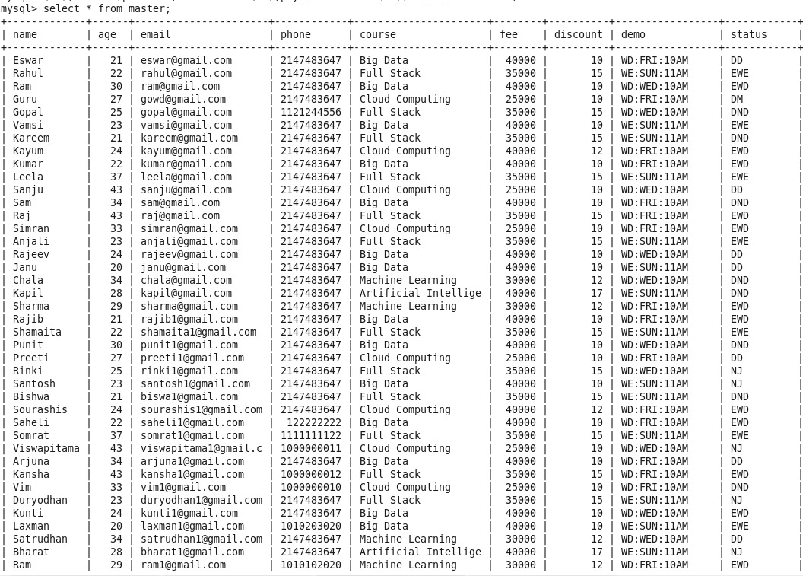
Master and Payment table in Mysql

Slide 7
Sqoop
Sqoop command to transfer master table from MySQl to HDFS
sqoop import --connect jdbc:mysql://192.168.11.134/student --username root --password cloudera --table master --target-dir /user/cloudera/master/ -m 1
Sqoop command to transfer payment table from MySQl to HDFS
sqoop import --connect jdbc:mysql://192.168.11.134/student --username root --password cloudera --table payment --target-dir /user/cloudera/payment -m 1

Slide 8
Tables in the Project
Enquiry Table
DEMO_SCHEDULE table – WEEKDAY_DEMO and WEEKEND_DEMO Table
DEMO_ATTENDED and DEMO_MISSED Table
COURSE_ENROLL – WEEKDAY_JOINING Table and
WEEKEND_JOINING Table
NOT_JOINED Table
Payment Table

Slide 9
Enquiry Table
We, have created the master table with the attributes Name, age, Email, Mobile_no , Course, Fee, Discount, Demo_Date, status_final which is our ORC table
Loaded the data from hdfs.
Query to create a table
create table enquiry(Name string, Age int,Email string,Phone string,Course string,Fee int,Discount int,Demo string,Status string) clustered by (Course) into 5 buckets stored as orc tblproperties('transactional'='true');

Slide 10
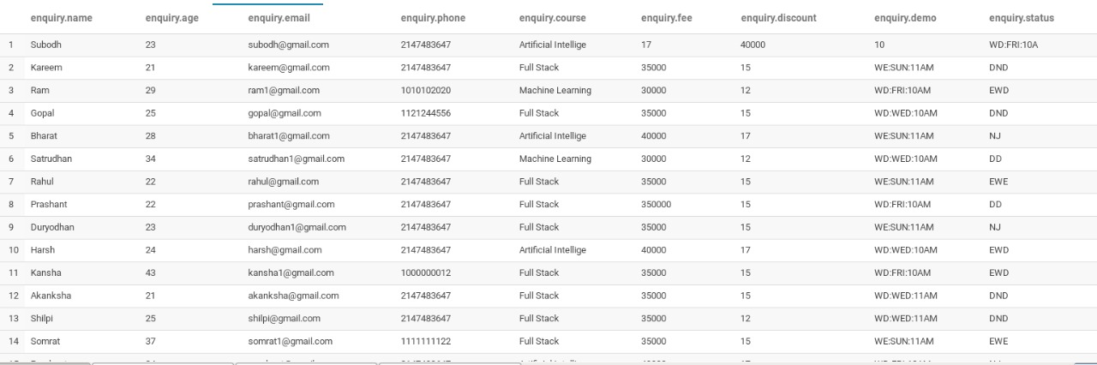
Enquiry Table

Slide 11
Weekday Demo_Schedule table
It is taken from enquiry table who has scheduled their demo with added attributes like demoday (WD,WE) ,day ,time.
Query:
create table weekday_demo(name string,age int,email string,phone string,course string,demo_day string,demo_time string) clustered by (course) into 5 buckets stored as orc tblproperties('transactional'='true');
We have used substr operator for extracting demo day and time from enquiry table where demoday is weekday.
Command for joining:
insert overwrite table weekday_demo select name,age,email,phone,course,substr(demo,4,3) as demo_day,substr(demo,8,4) as demo_time from enquiry where substr(demo,1,2)=='WD';

Slide 12
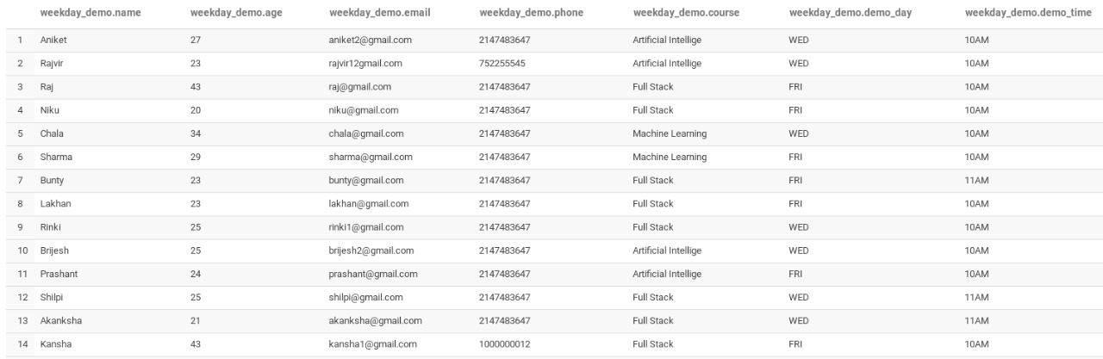
Weekday demo table

Slide 13
Weekend demo Table
Query:
create table weekend_demo(name string,age int,email string,phone string,course string,demo_day string,demo_time string) clustered by (course) into 5 buckets stored as orc tblproperties('transactional'='true');
We have used substr operator for extracting demo day and time from enquiry table where demoday is weekend.
Command for joining:
insert overwrite table weekend_demo select name,age,email,phone,course,substr(demo,4,3) as demo_day,substr(demo,8,4) as demo_time from enquiry where substr(demo,1,2)=='WE';

Slide 14
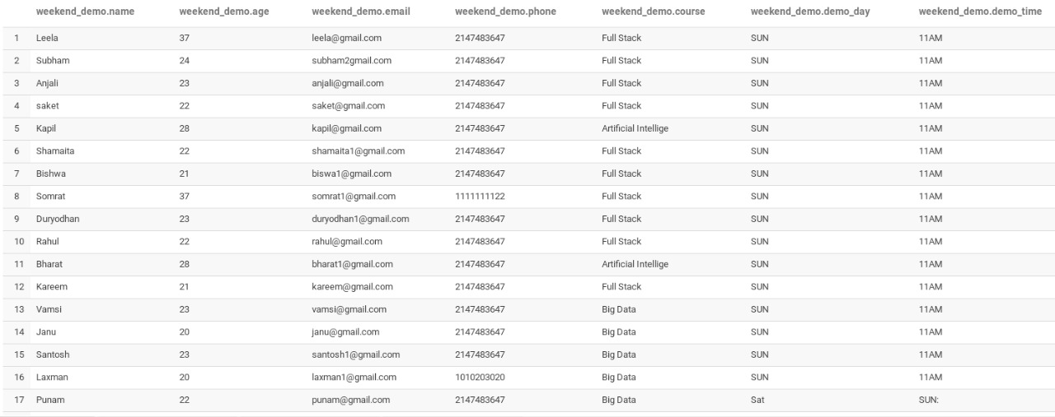
Weekend Demo Table

Slide 15
DEMO_done table
create table demo_done(name string,age int,email string,phone string,course string,week string,demo_day string,demo_time string) clustered by (course) into 5 buckets stored as textfile;
insert overwrite table demo_done select name,age,email,phone,course,case when substr(demo,1,2)=='WD' then 'WEEKDAYS' when substr(demo,1,2)=='WE' then 'WEEKEND' end,substr(demo,4,3) as demo_day,substr(demo,8,4) as demo_time from enquiry where status!='DND';

Slide 16
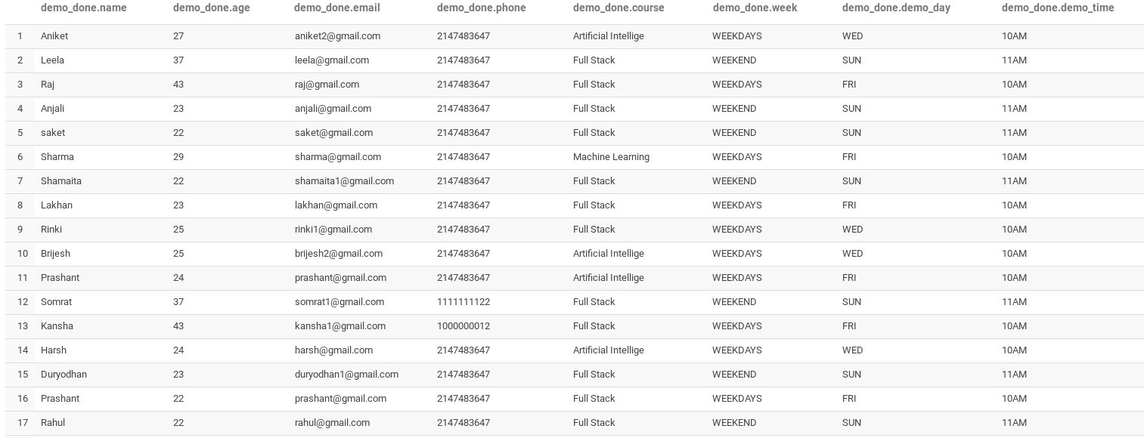
Demo_done table

Slide 17
Demo Not Done Table
The data for table is taken from Enquiry table whose status is DND
create table demo_not_done(name string,age int,email string,phone string,course string,week string,demo_day string,demo_time string) clustered by (course) into 5 buckets stored as orc tblproperties('transactional'='true');
insert overwrite table demo_not_done select name,age,email,phone,course,case when substr(demo,1,2)=='WD' then 'WEEKDAYS' when substr(demo,1,2)=='WE' then 'WEEKEND' end,substr(demo,4,3) as demo_day,substr(demo,8,4) as demo_time from enquiry where status='DND';

Slide 18
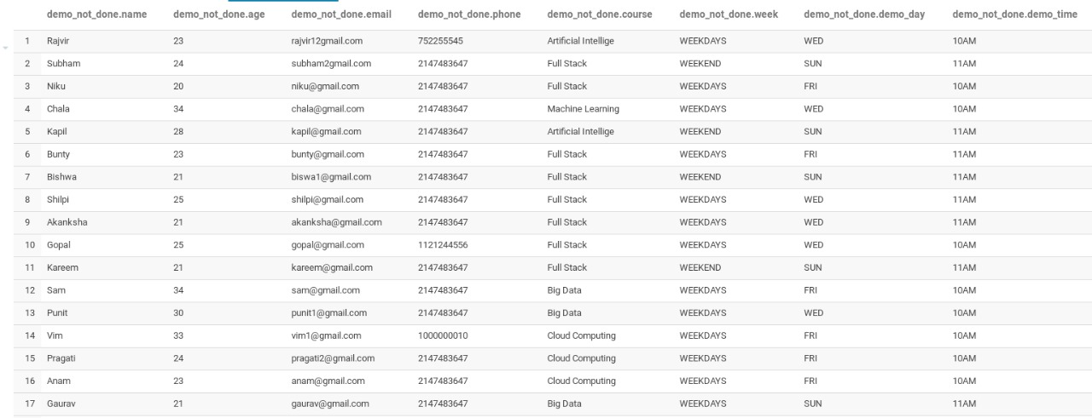
Demo Not Done Table

Slide 19
Weekdays Joining Table
create table weekdays_joining(name string,age int,email string,phone string,course string,fee int,discount int) clustered by(course) into 5 buckets stored as orc tblproperties('transactional'='true');
insert overwrite table weekdays_joining select name,age,email,phone,course,fee,discount from enquiry where status='EWD';

Slide 20
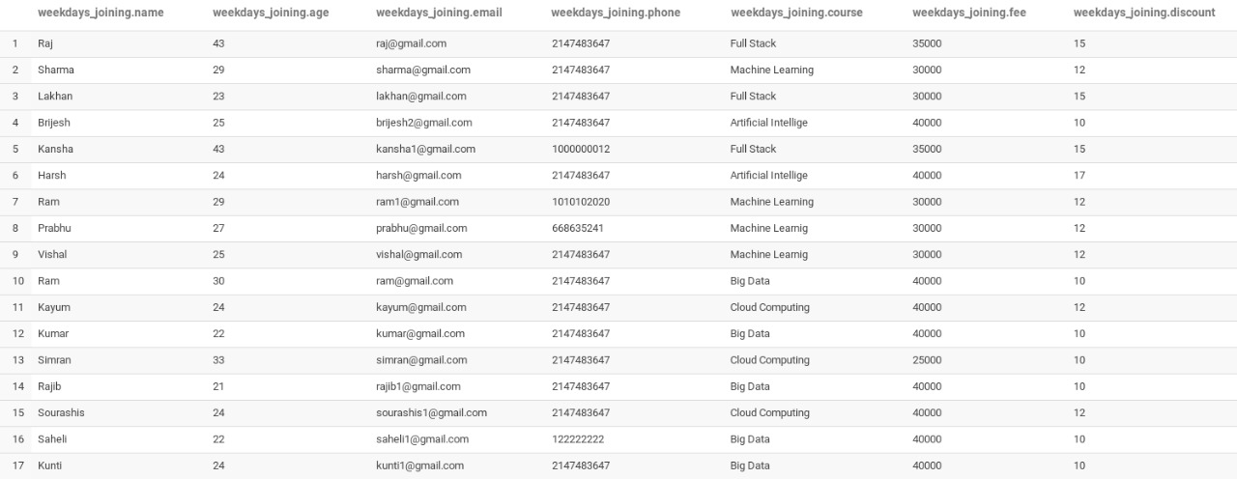
WeekDays Joining Table

Slide 21
WeekEnd Joining Table
create table weekend_joining(name string,age int,email string,phone string,course string,fee int,discount int) clustered by(course) into 5 buckets stored as orc tblproperties('transactional'='true');
insert overwrite table weekend_joining select name,age,email,phone,course,fee,discount from enquiry where status='EWE';

Slide 22
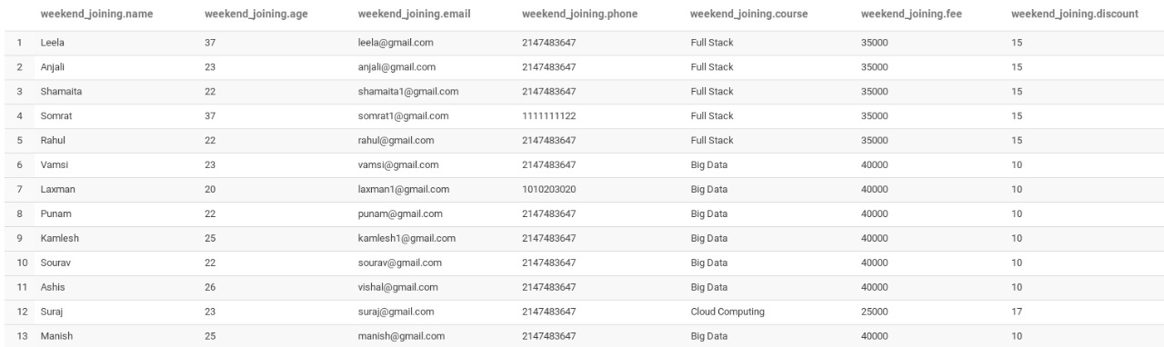
WeekEnd Joining Table

Slide 23
Not Joined Table
create table not_joined(name string,age int,email string,phone string,course string,fee int,discount int,type string) clustered by(course) into 5 buckets stored as orc tblproperties('transactional'='true');
insert overwrite table not_joined select name,age,email,phone,course,fee,discount,case when substr(demo,1,2)=='WD' then 'Weekdays' else 'Weekend' end from enquiry where status='NJ';

Slide 24
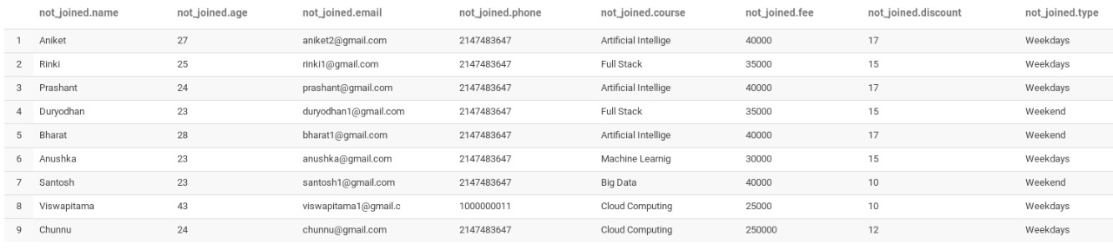
Not Joined Table

Slide 25
Payment Table
create table payment(name string,age int,email string,phone string,course string,type string,fee int) stored as orc tblproperties('transactional'='true');
insert overwrite table payment select name,age,email,phone,course,case when substr(demo,1,2)=='WD' then 'Weekdays' else 'Weekend' end,fee from enquiry where status='EWE' or status='EWD';
alter table payment add columns(paid int,mode string,pay_mode string,no_of_install int,due_date string);
insert overwrite table payment select p.name, p.age, p.email, p.phone, p.course,p.type, p.fee,j.paid,j.mode,j.pay_mode,j.no_of_install,j.due_date from payment p left join payment j on p.name=j.name;

Slide 26
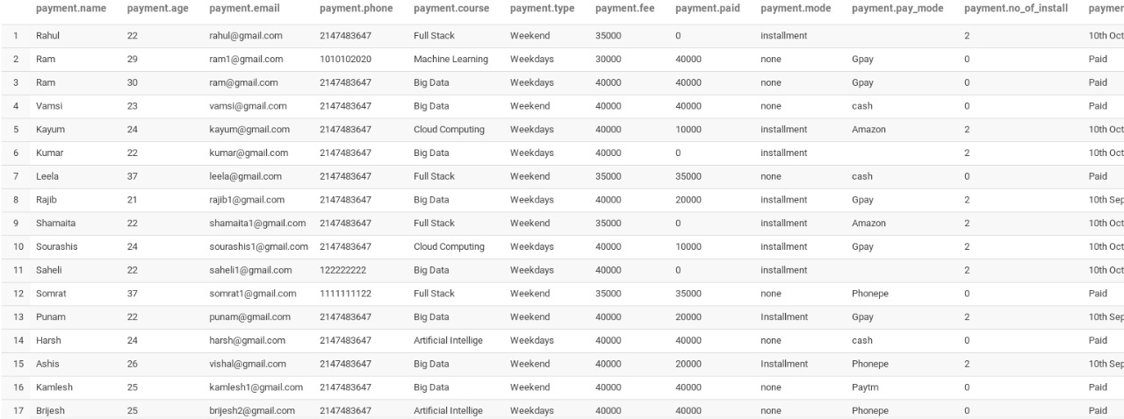
Payment Table

Slide 27
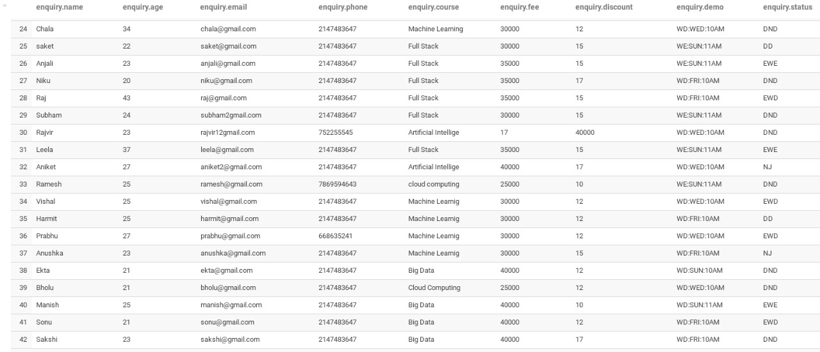
APpending Record to enquiry Table
insert into table enquiry values("Ramesh",25,"Ramesh@gmail.com",
'7869567860','Cloud Computing',25000,10,'WE:SUN:11AM','DND');

Slide 28
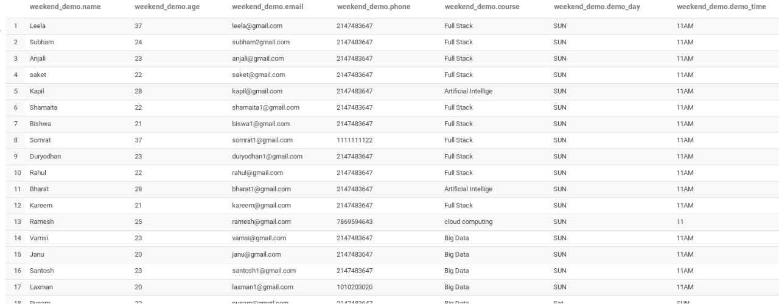
Upadte Weekend_Demo Table
insert into table Weekend_demo values("Ramesh",25,"Ramesh@gmail.com",
'7869567860','Cloud Computing','SUN','11AM');

Slide 29
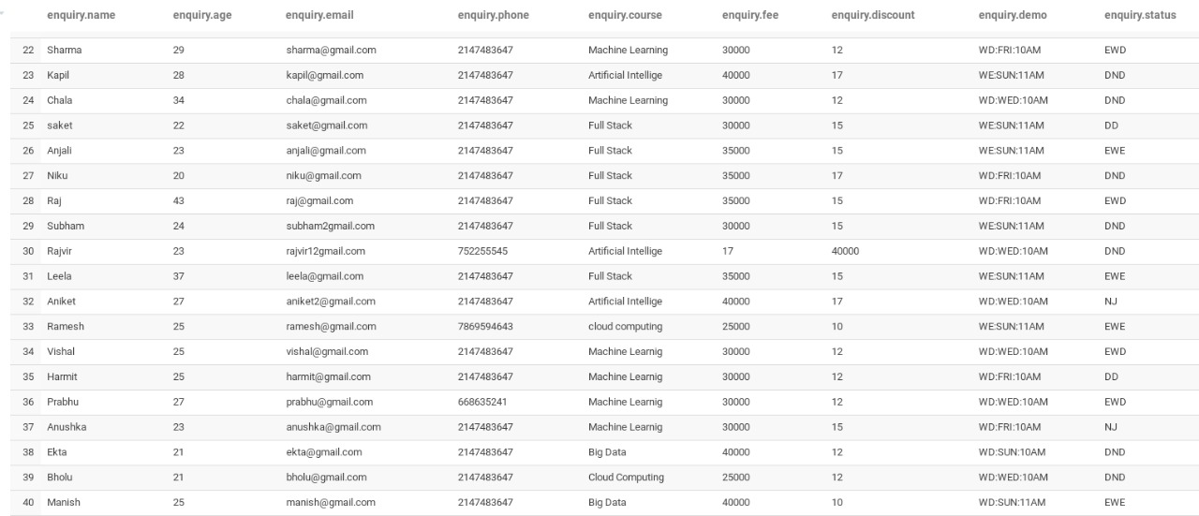
Update Student in Enquiry Table
update enquiry set status='EWE' where name='Ramesh';

Slide 30
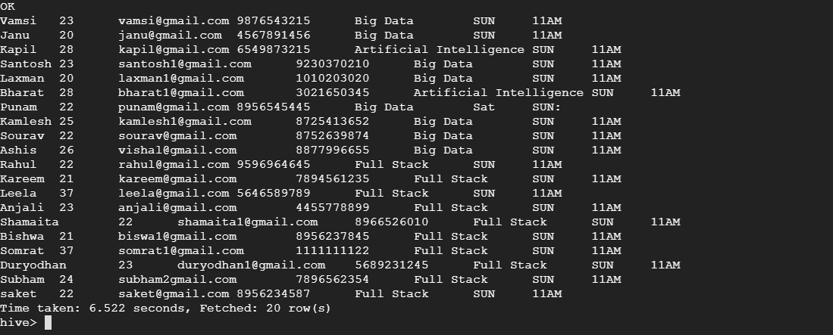
Deleting Student From Weekend_Demo Table
delete from Weekend_demo where name='Ramesh';

Slide 31
Queries Performed
1. Query for the number of students missed the demo with respect to their courses.
select course,count(course) as cnt from demo_not_done group by course order by course;
2. Display the names of the courses that are offering in the institute
select DISTINCT course from enquiry;
3. Students details who paid the fee
select * from payment where due_date='Paid';
4. Student details who are not done with payment
select * from payment where due_date!='Paid';
5. Student details who enrolled for Big Data in Weekend
select * from weekend_joining where course='Big Data';

Slide 32
Queries Performed
6. Student details who enrolled for Machine Learning course in Weekdays
select * from weekdays_joining where course='Machine Learning';
7. Student details who are enrolled for Full Stack in both Weekend and Weekdays
select * from enquiry where course='Full Stack' and (status='EWE' or status='EWD');
8. Find the number of students who have not joined the institute after completion of demo.
select count(*) from not_joined;
9. Student details who are opted for online payment mode.
select * from payment where pay_mode!='cash';
10. Query to extract courses and the number of students enrolled for each course.
select course,count(course) as cnt from enquiry where status='EWE' or status='EWD' group by course order by course;

Slide 33
Queries Performed
11. Student details who have paid the more than half of the course fee
select * from payment where paid>=(fee/2);
12. Query to update student Eswar status to drop.
update enquiry set status='Drop' where name='Eswar';
select * from enquiry where name='Eswar';
Eswar 21 eswar@gmail.com 7780263965 Big Data 40000 10 WD:FRI:10AM Drop
13. Append a new record to enquiry table with demo scheduled on Thursday 10pm
insert into table enquiry values("Zakreen",26,"zak@gmail.com",'7865475634','Artificial Intelligence',35000,15,'WD:THURS:10PM','DND');
14. Extract the student details who have discount less than or equal 10
select * from enquiry where discount<=10;

Slide 34
Queries Performed
15. Students details who enrolled for course Big Datat
select * from weekend_joining where course='Big Data';
16. students who joined course cloud computing from weekend
select * from weekdays_joining where course='Cloud Computing';
17. students with age more than 24
select * from enquiry where age > 24;
18. students who having age more than 40 and from Big data course
select * from enquiry where age > 40 and course = 'Big Data';
18. students who got more than 10 % discount and age more than 22
select * from enquiry where discount<=10 and age >22;
19. all the course and their fee from enquiry table
select course,fee from equiry;

Slide 35
Queries Performed
20. Query to find all the age groups enrolled and their count in descending order.
select age,count(age) from enquiry group by age order by age desc;
21.Query to extract the phone number of students who missed the demo
select phone from demo_not_done;
22. Query to extract the count of students missed demo based on the course
select course,count(course) from demo_not_done group by course;
Query to find the count of students missed the demo based on the week mode they opted.
select week, count(week) from demo_not_done group by week;

Slide 36
Queries Performed
23. Students number who have joined in weekdays.
Select count (*) from weekdays_joining;
24. Demo scheduled on Sunday and is not done yet.
Select * from enquiry where substr(demo, 4, 3)=’SUN’ and status=’DND’;
25. Students have joined in weekdays and in Big Data Course
Select * from weekdays_joining where course=’Big Data’;

Slide 37
Features of this project
We used the MySQL, Sqoop, Hive and Hue Technologies
The Payment Table has option like installment, Number of installment and due date of payment
We have one more column, payment mode i.e., cash or online(Phonepe,Gpay,Paytm)
This project is user friendly as it has features like updation, appending and deletion features
Performed various queries

Slide 38
Thank You

